Slide 1
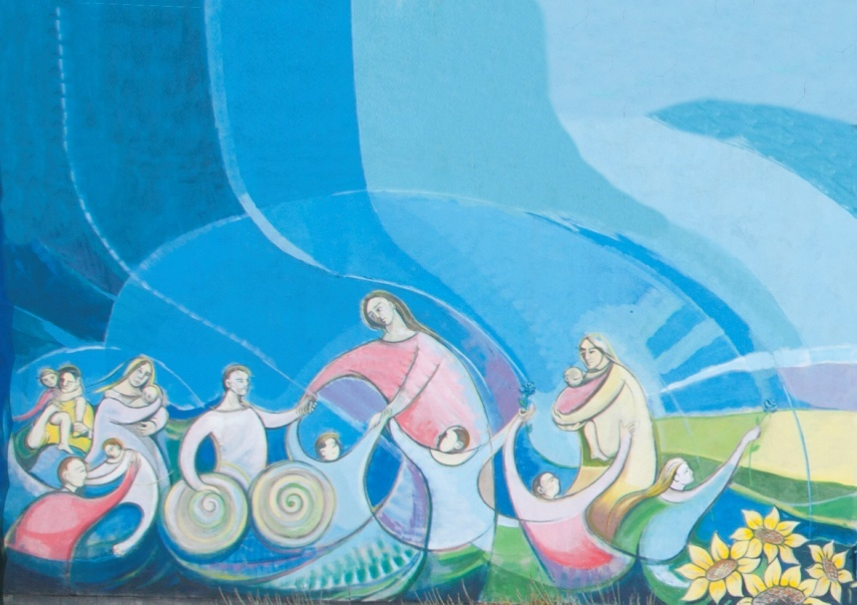
Come to me … all, any of You:
… I will welcome You and give You shelter
-------------------------------------------------
Venite a me … tutti: … vi accoglierò e vi darò rifugio

Slide 2
History
On June 26, 2008, in Rome, The Fondazione Internazionale Il Giardino delle Rose Blu O.N.L.U.S. was incorporated, to unify and synergize various initiatives created by Don Ermanno D’Onofrio, operating in the area of Frosinone (Italy) and elsewhere.

Slide 3
The “Blu Roses”
The “Blu Roses”* in our name are the small ones, the poor, the suffering, the starving ones: like the Blu Roses, they are rare, most fragile and they demand attention, respect, care, affection … Love, in a single word! *suggested by the late Bishop of Frosinone, Mons. Salvatore Boccaccio.

Slide 4
History - 2
Since April 12, 2013, the Fondazione is recognized also in Croatia, and listed in the Representative Office of Foreign Foundations. Its commitment is to promote its values, educate and train new Volunteers. The same procedure was started in Bosnia-Herzegovina.

Slide 5
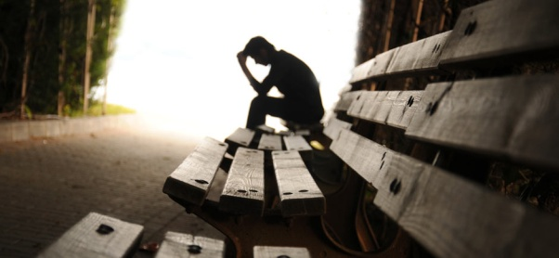
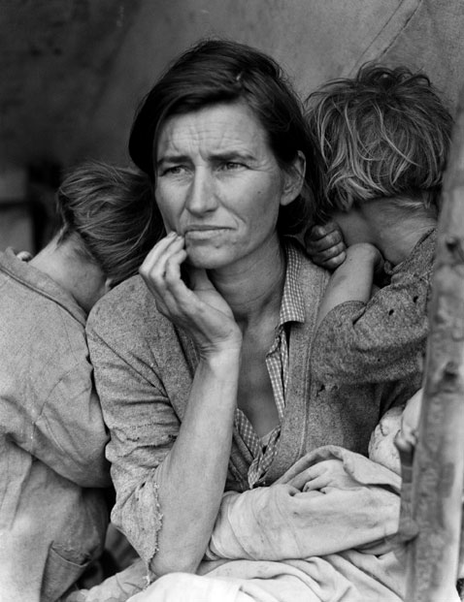
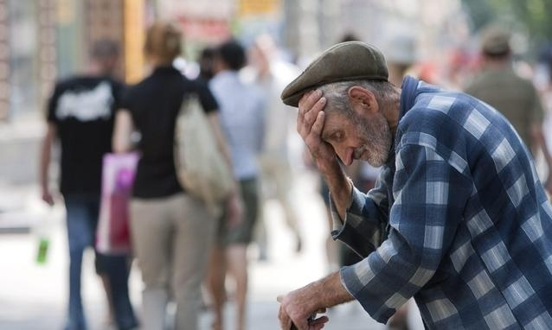
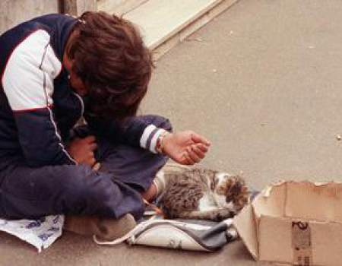
Mission / 1
The Fondazione acknowledges the human and spiritual value of those who live a condition of pain, committing itself to serve and support the small ones and those who are vulnerable and helpless.

Slide 6
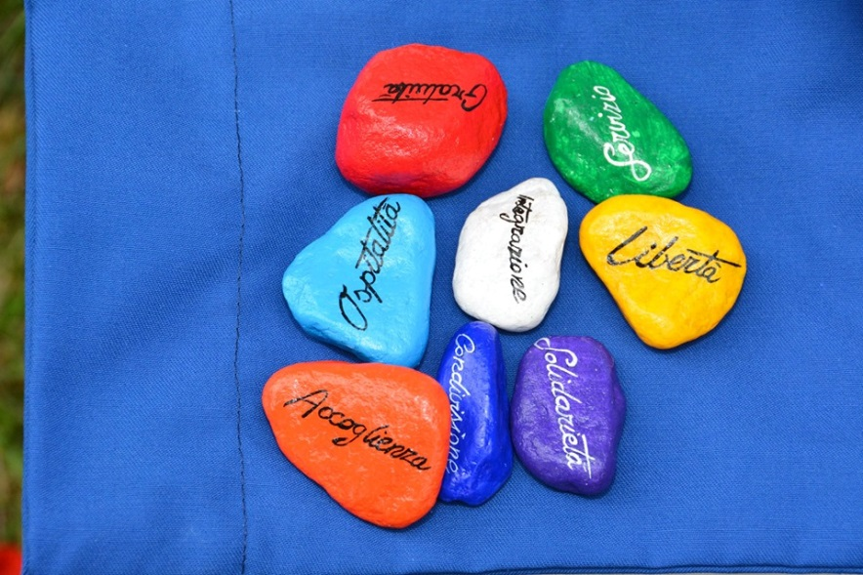
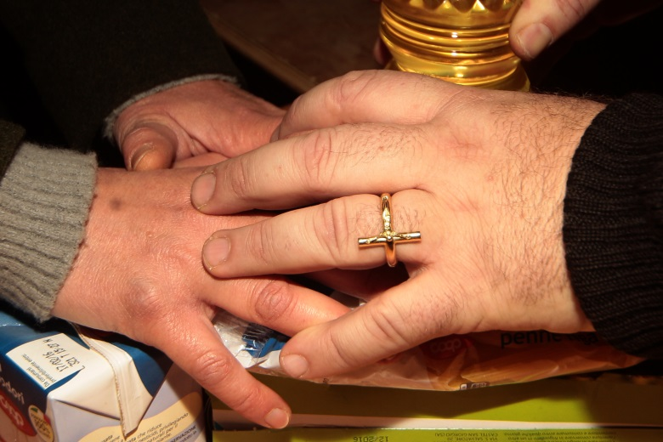
Mission / 2
Servicing, Sharing, Sheltering, Hospitality, Gratuity, Liberty, Integration and Solidarity are the pillars of the Fondazione’s Mission. Its commitment in the social environment is the support to minors and those who are in need.

Slide 7
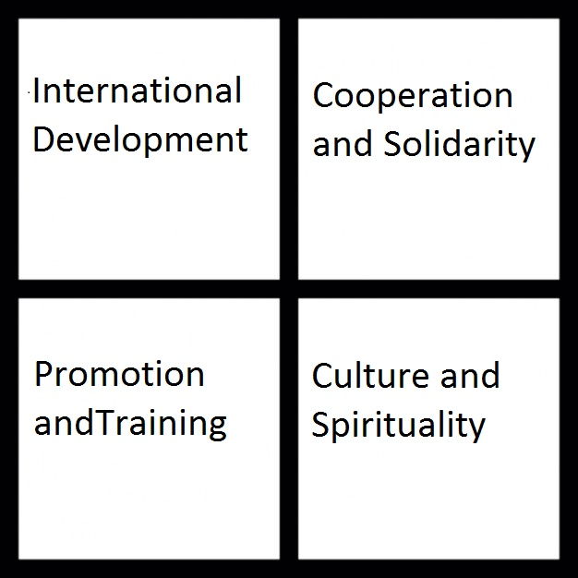
The Organization
The main operating Tasks and Objectives of the Fondazione are very ambitious, divided in four Areas:

Slide 8
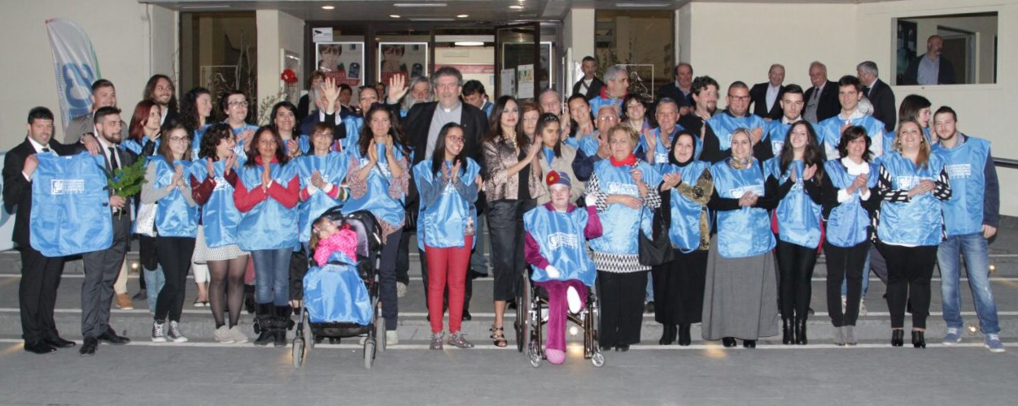
1. International development Area
The volunteers in this Area look mainly after the promotion of the Voluntaristic commitments abroad, through their own experience and Training. The promotion of our founding values tends to approaching new Volunteers in emerging Countries, like Croatia and Bosnia-Herzegovina, where it all began in 1993.

Slide 9
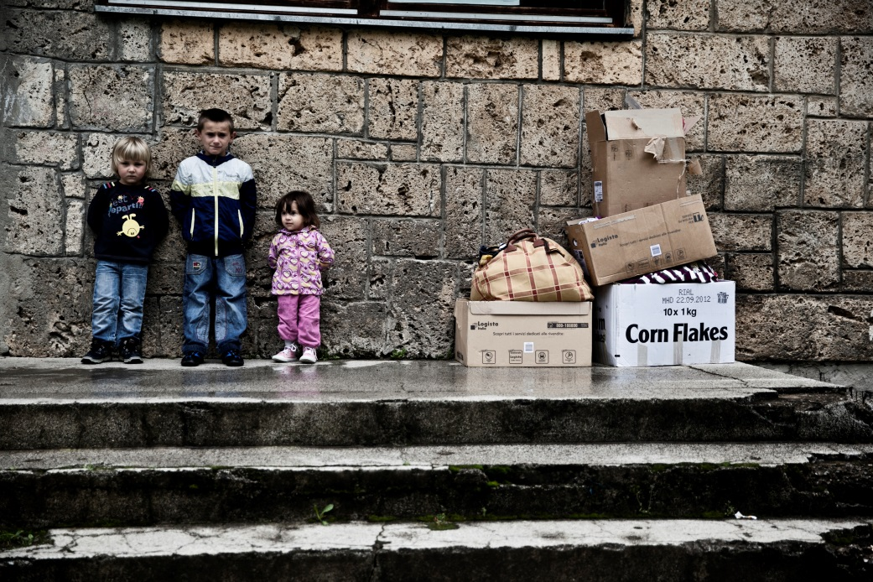
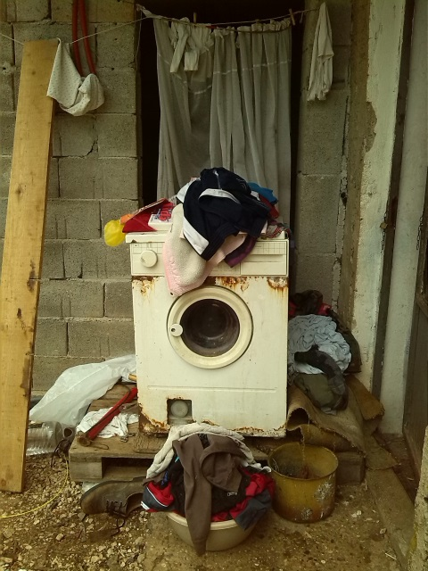
2. Cooperation and Solidarity Area
The Projects promoted in this Area are aimed at helping people who live in conditions of need, discomfort, poverty and sickness. It is a core Area. It deals with the basic values of the Mission and its karisma through Voluntary experience, enhancing the humanitarian aspects to face conditions of discomfort and poverty. The initiatives are realized in connection with the other Operating Areas, in the originating Countries or abroad.

Slide 10
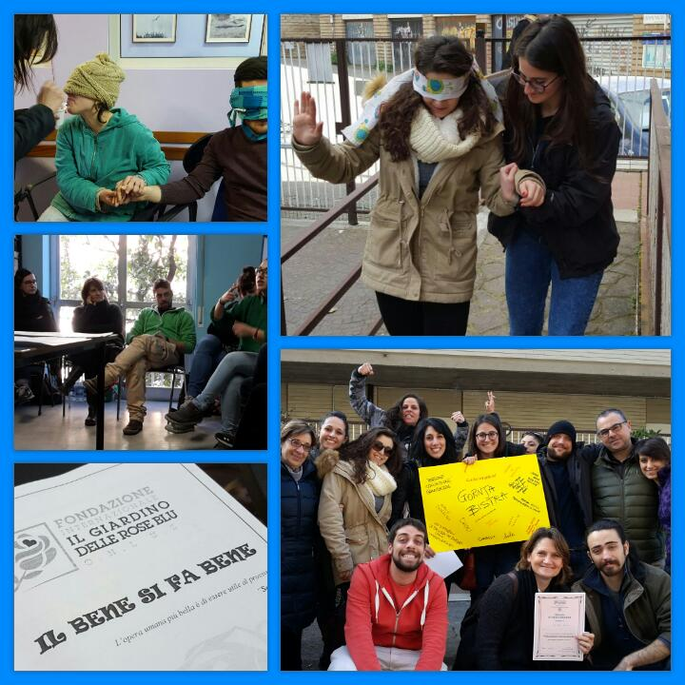
3. Promotion and Training Area
The objectives of this Area are: Promoting our Values and Mission, approaching, training and motivating new volunteers. Testimonials, events, meetings, conventions and seminars, are its operating tools. Training sessions, encounters and meetings are also used for training new Volunteers. A vital task for this Area is the collection of Funds which, in addition to membership fees, are used to sustain our necessities, calling newcomers to become part of the Family “Il Giardino delle Rose Blu”.

Slide 11
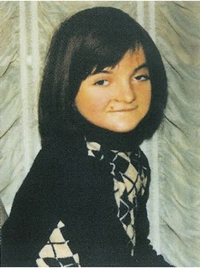
4. Culture and Spirituality Area
We respect the Liberty and the religious belief of our Volunteers but those who operate in this Area are committed to testifying the Christian evangelical values, the spiritual pillars of the Fondazione. We operate via testimonials and the knowledge and promotion of the figure of God’s Servant Daniela Zanetta and her life. Special attention is paid to the Family, the basic community where living and growing, even spiritually. In this Area the Volunteers of any religious belief are integrated and can freely express their own point of view.

Slide 12
The Projects
The information and realization of all projects in each Country is made possible by the presence of Project Managers, by the various Referents, located capillarily in each Italian Region, by affiliated Associations and Organizations and by Donors who share the Fondazione’s objectives and its Mission.

Slide 13
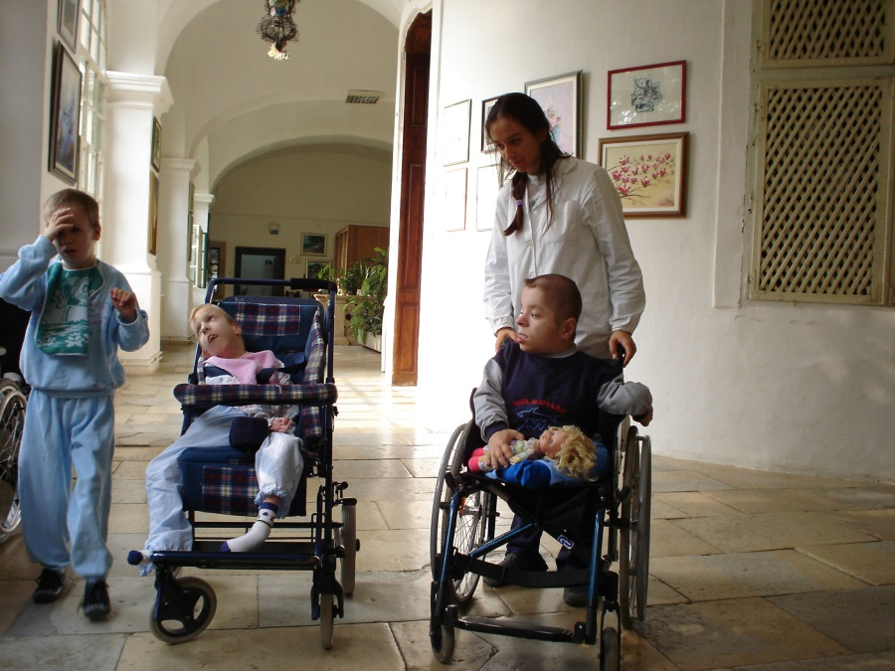
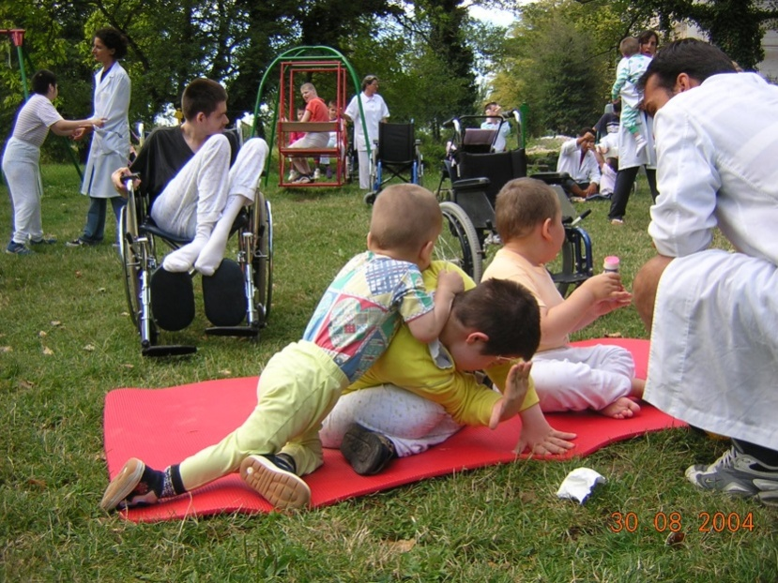
Permanent Camp
Our core commitment is in Gornja Bistra, Croatia, through the Permanent Camp, which provides the constant presence of volunteers at the local Pediatric Hospital. The volunteers, since January 2, 2002, ensure their cooperation in the assistance to the patients through the “BRosGaMe”, educational and rehabilitational methodology studied by Don Ermanno D’Onofrio and other professional volunteers. As of today, we have recorded the presence of more than 9,000 Volunteers .

Slide 14
Summer Camp – Tendopoli - 1

Slide 15
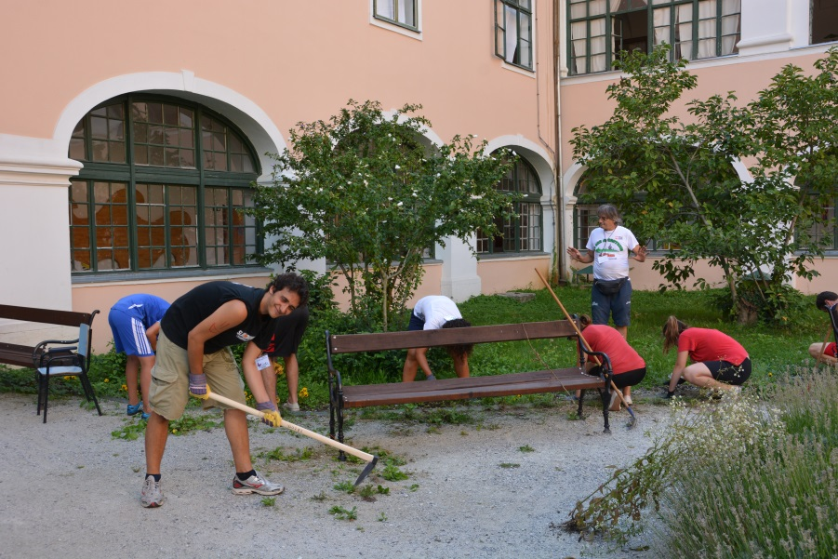
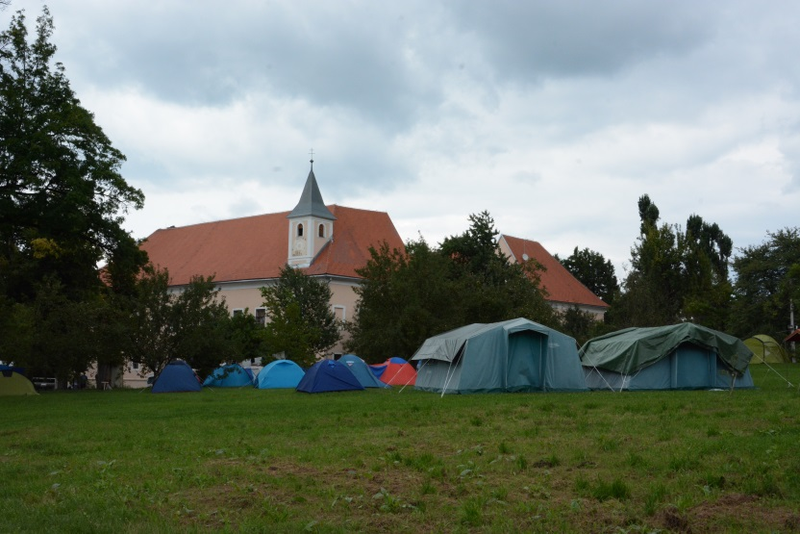
Summer Camp – Tendopoli - 2

Slide 16
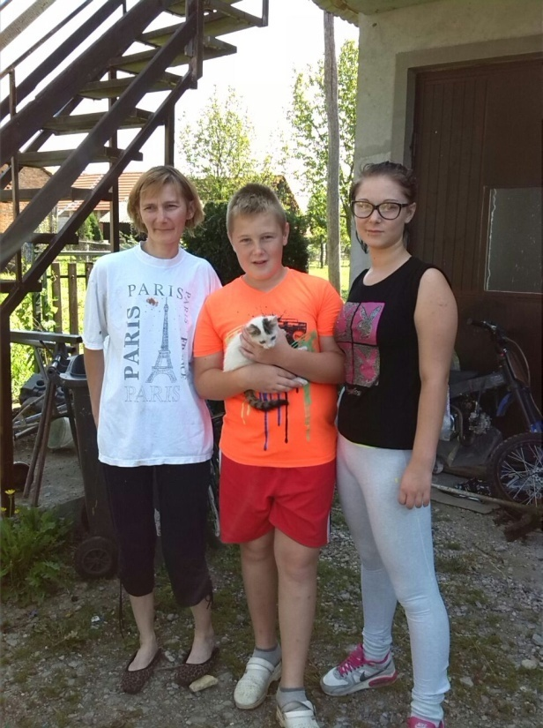
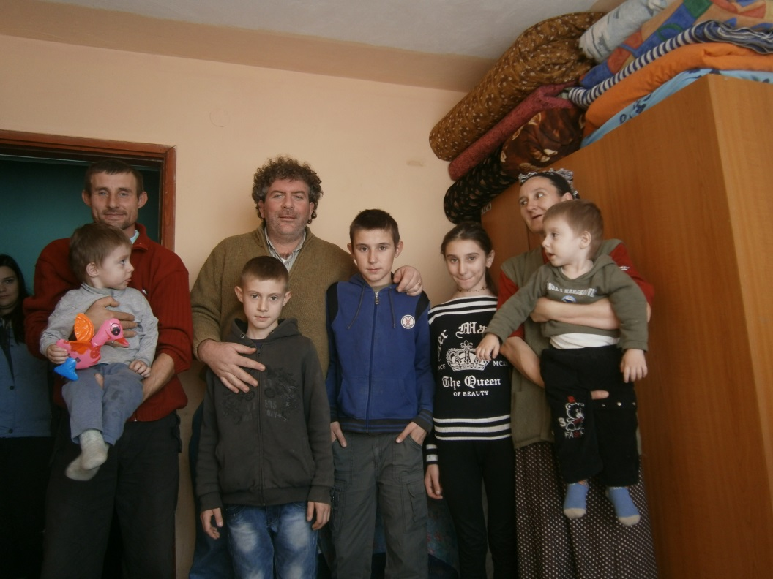
The Bridge of Smiles
- This project «The Bridge of Smiles», particularly relevant, concerns the support to many poor and helpless families in Croatia and Bosnia-Herzegovina, through the aid provided by generous Donors.

Slide 17
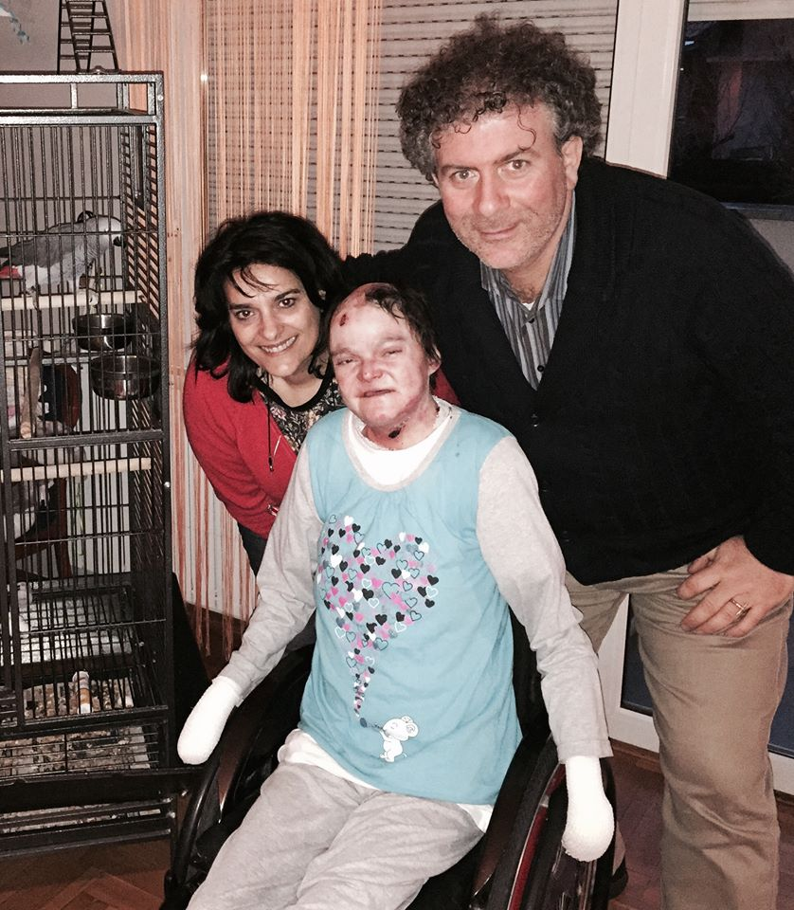
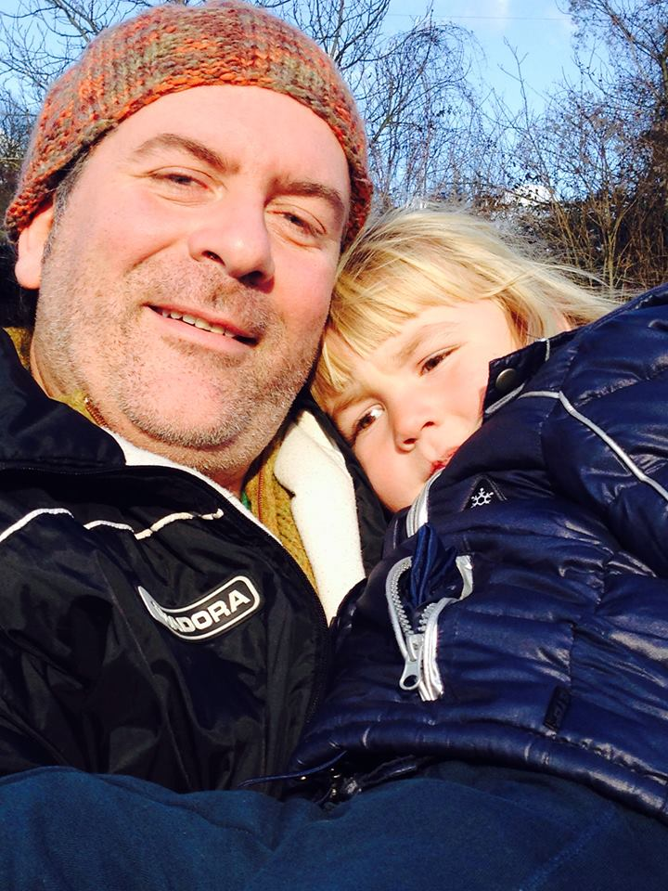
A.M.I. - Medical care in Italy
Within the framework of this project, we have been able to activate many humanitarian actions which have helped many difficult situations by guaranteeing assistance and specialized medical care in Italian structures.

Slide 18
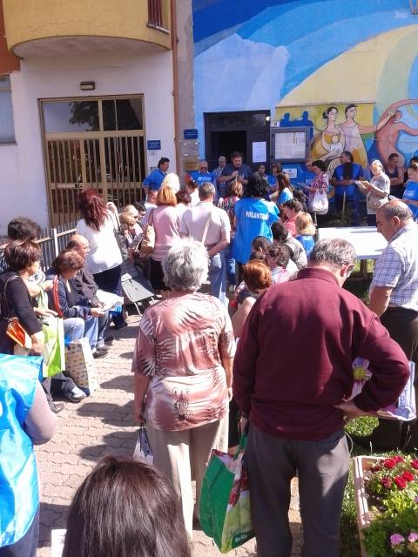
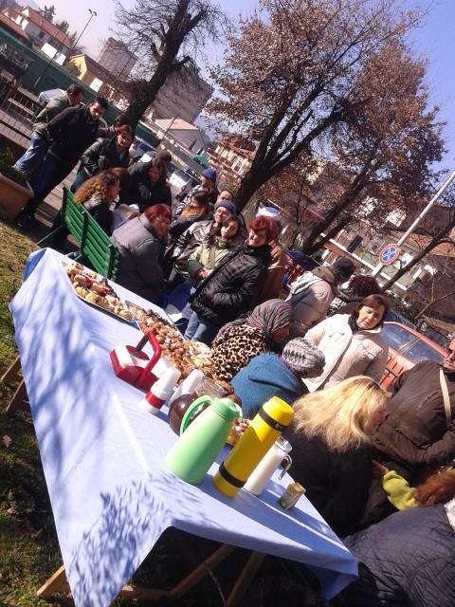
Let’s Feed the Solidarity
- This project provides food and other aid and support to numerous needy families who are facing conditions of poverty and discomfort. The project «Albatros» provides support to minors by after-school tuition, occupational training and Summer educational vacations.

Slide 19
House of Roses / 1
This project is underway since we need to offer our Volunteers an adequate facility where to stay during their permanence in Gornja Bistra for the Permanent Camp. The small pre-fabricated structure used until now is no more safe and secure to accomodate them during their service period in support of the hospitalized patients.
To satisfy this need the Fondazione has conveniently acquired, on February 11, 2016, a house, requiring important restoration, situated at 300 m from the hospital entrance.

Slide 20
House of Roses / 2
The project is meant to be twofold: not only a place to accomodate the Volunteers, but also to be the seat for the Residential European Educational Center for International Volunteers where Croatian and Bosnian-Herzegovinian volunteers, but also others coming from the rest of Europe, will be trained and will have the seat for their activities.

Slide 21
House of Roses: the project

Slide 22
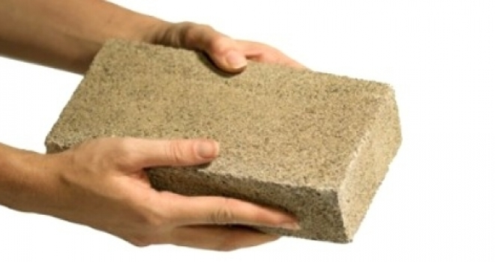
The Rose Petals
The initiative “Rose Petals” has been launched to collect the funds required to realize the structure: the Petals are the bricks necessary to build the House.
In order to remember the solidarity and the generosity of the Donors who will contribute to the project, we offer a brick on which the name of the Donor (or any relative or friend of his choice), will be carved. The Bricks will be used to make the walking path to the House and/or soma of the inner walls of the House of Roses.

Slide 23
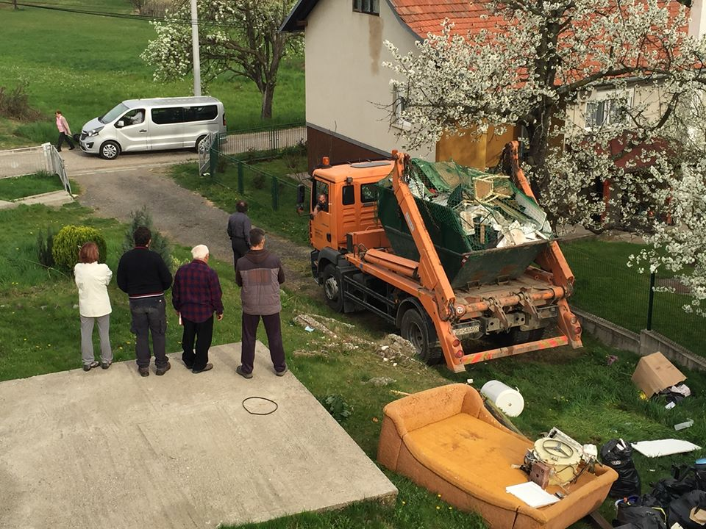
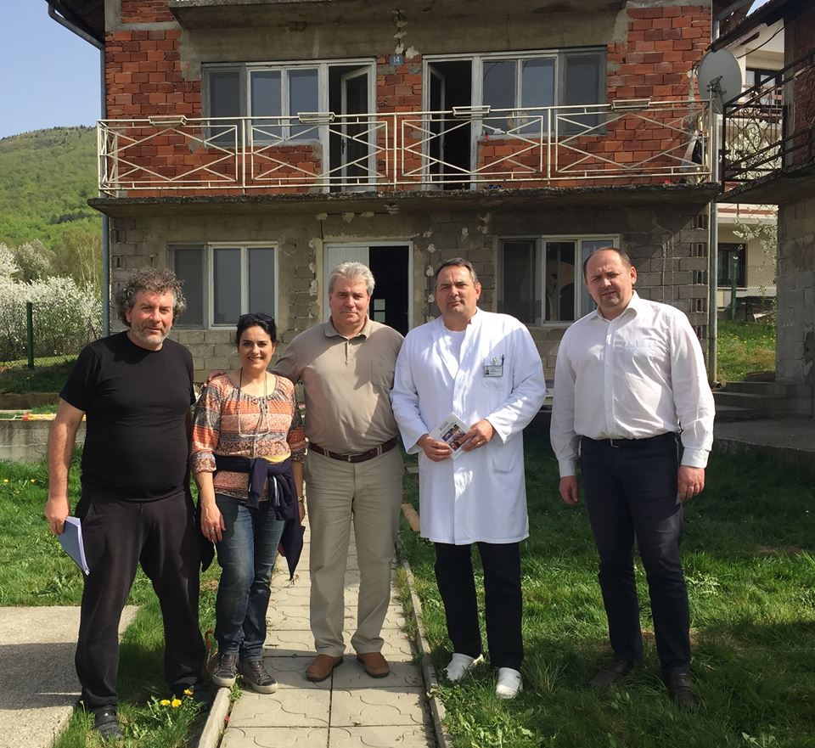
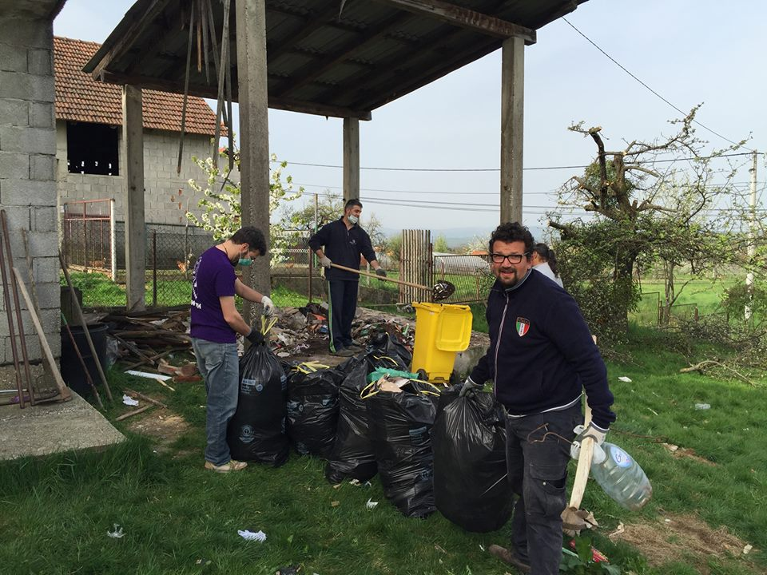
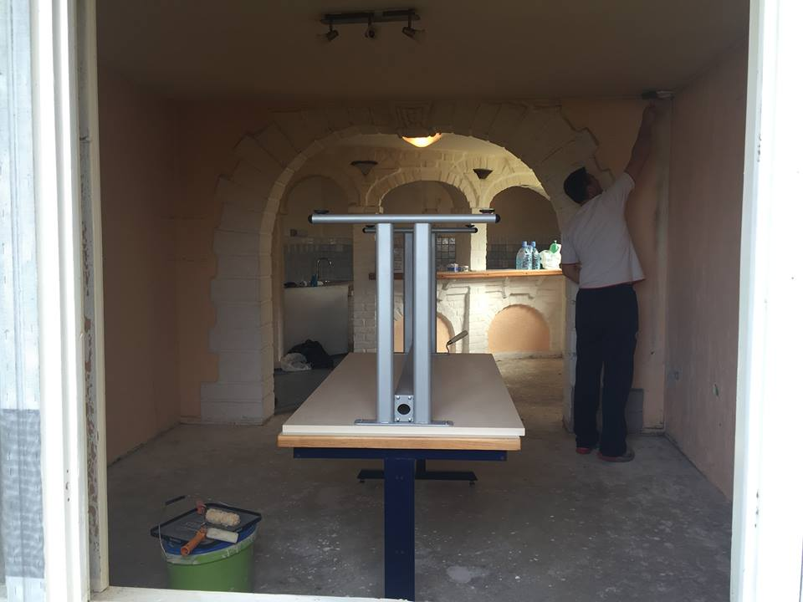
House of Roses

Slide 24
Family and Marriage Consulting

Slide 25
Educational Division - CISPeF

Slide 26
We deeply thank you for Your sensibility and generosity in helping us promote the project, informing and approaching new Donors, thus contributing to realize our projects in favour of the Blu Roses everywhere.

